Slide 1
Static Website for a start-up
Yash Lodhiya (A1)
Roll no.- 55
This website was created for my friend who owns a game server and wanted to market it

Slide 2
The website is hosted by netlify
https://deathfeud.netlify.app/
Here is the link for website

Slide 3
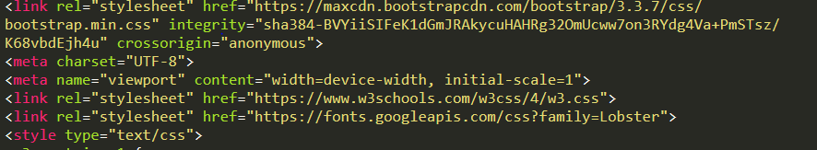
The CSS used in the html provided is provided by w3schools,google fonts and some bootstrap

Slide 4
The content of the webpage is divided into main parts
The navbar (header)
The team section (the team of startup)
The Pricing Section (prices for access of game server)
The server section (for status of servers)
Contact us section (footer)

Slide 5
The navbar
For making the website user friendly i made the navbar so the users can navigate to there section by clicking the link. And for connecting the navbar to the html i used some classes like #about and #pricing
Note- for some reason the navbar is not visible in phones, i tried searching for it on stackexchange and websites like that if you have a solution please email me thank you!

Slide 6
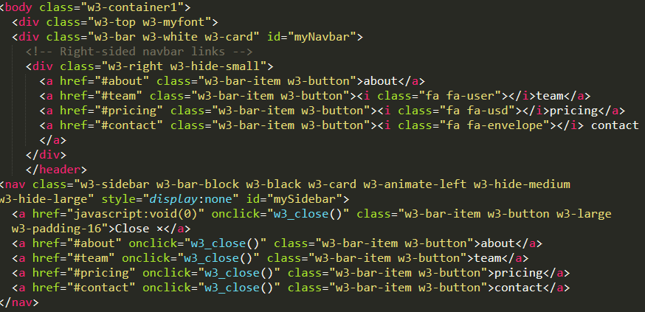

Slide 8
The team section
The team section is nothing but the info about the employees who made the start-up possible. I used the code of w3 schools to make this section as you can see in the next slide

Slide 9
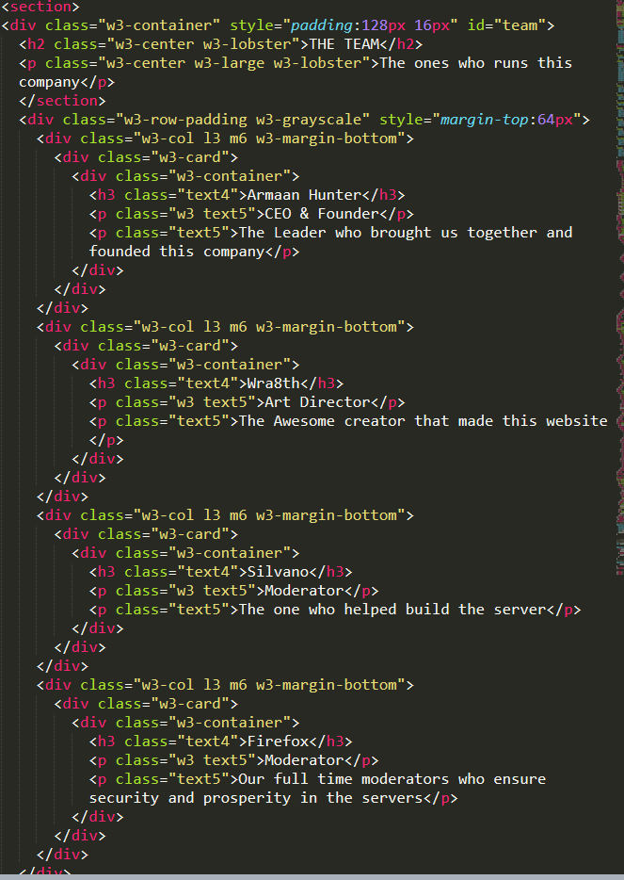

Slide 10


Slide 11
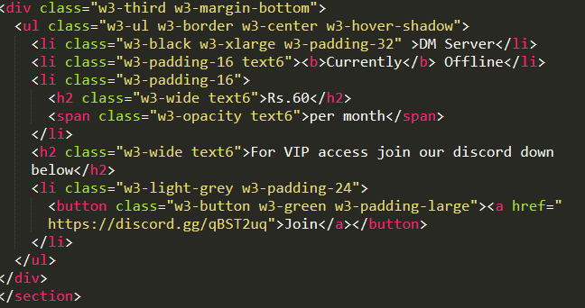
The pricing section
For pricing section i used a default pricing tab from w3 schools
For the discord link i used a normal href tag which on clicking leads to the discord server

Slide 12
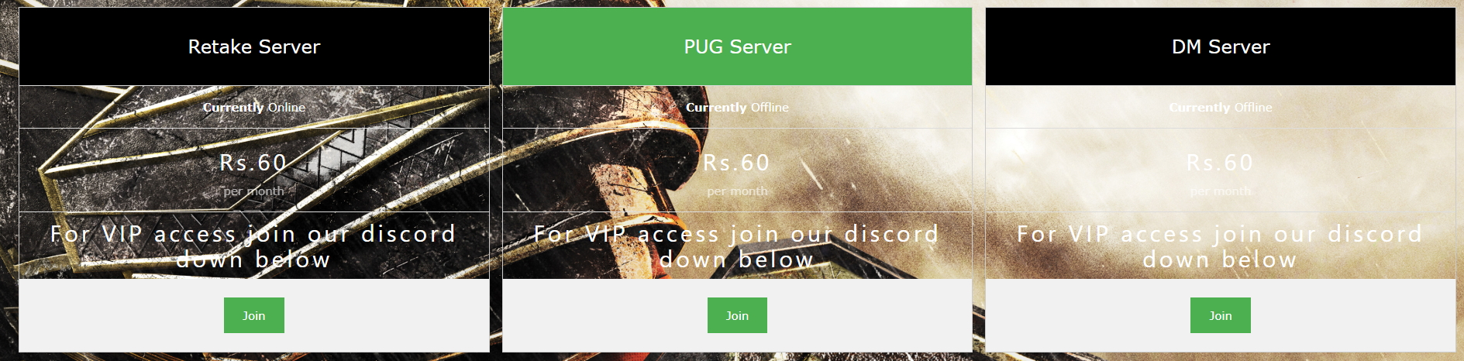

Slide 13
Server section
For server status i made a table and listed the servers available.
When you click on join it opens steam and launches the game (CS:GO) and connects to the server

Slide 14
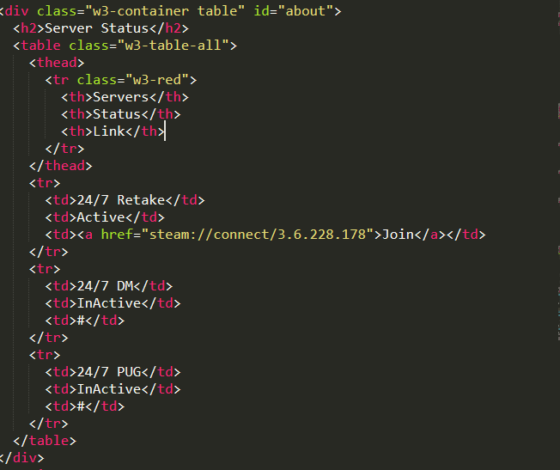

Slide 15
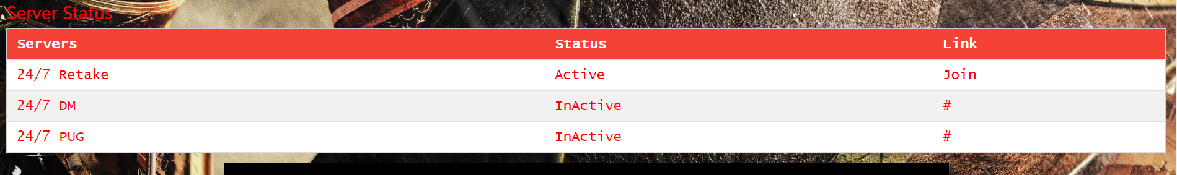

Slide 16
Contact us section
I used a normal footer tag and a black background for footer
And of-course i had to include my name on credits :)

Slide 17
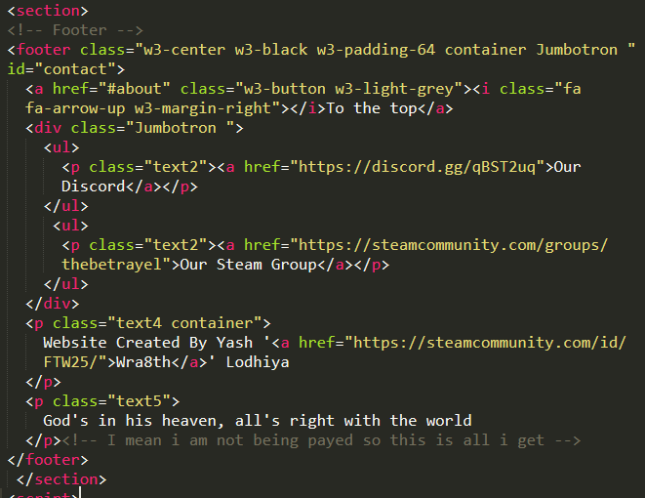

Slide 18
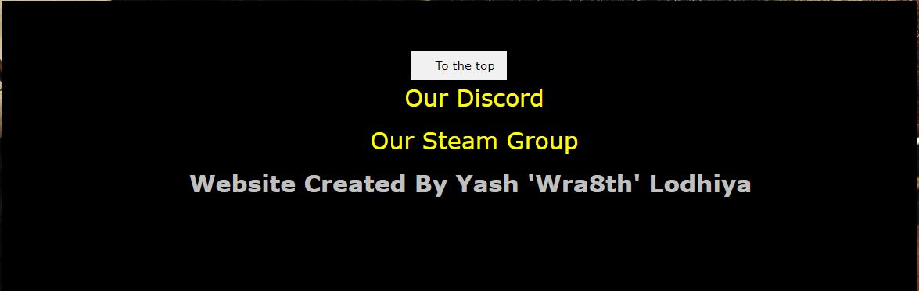

Slide 19

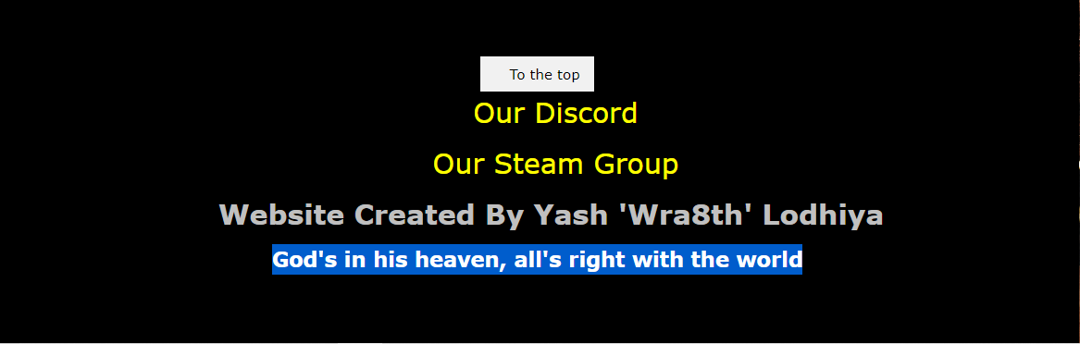
Note: if you notice closely there is a empty space in the footer
So, i had limited creative access in the website and i didnt get paid so i left a bit of trademark(a quote from my all time fav. anime) there which you can only see if you select it like this:

Slide 20
Thank you!

